Slide 1


BIORESOURCES IN FOOD PROCESSING
Himakshi Baishya
Assistant Professor (Food Processing Technology)

Slide 2
Course
ANIMAL BASED BIO-
INTRODUCTION TO
BIO-RESOURCES
RESOURCES IN FOOD
RAW MATERIALS FOR FOOD PROCESSING
PROCESSING
UNIT-1
UNIT-2
UNIT-3
UNIT-4
UNIT-5
PLANT BASED BIO- RESOURCES IN FOOD PROCESSING
MICRO-ORGANISMS AS BIORESOURCES IN FOOD PROCESSING

Slide 3
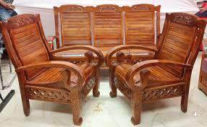
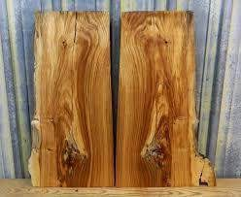
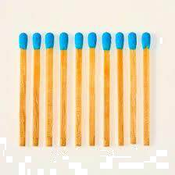
Resources are anything that has utility and adds value to our life.
Air, water, food, plants, animals, minerals, metals, and everything else that exists in nature and has utility to mankind is a ‘Resource’.

Slide 4
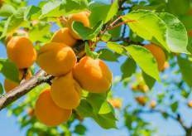

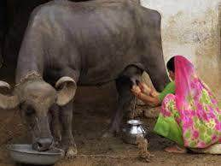
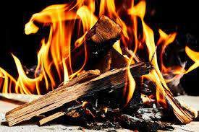
INTRODUCTION TO BIO-RESOURCES
Bioresources are non-fossil, biogenic, renewable and biodegradable materials that can be applied by humans for purposes including
Food
Essential products and
Energy
Bioresources are considered as life generated materials and processes that are naturally and
sustainably renewable and biodegradable.
Bioresources primarily consist of a wide range of materials, such as plants, animals, microorganisms, and waste products from various industries and municipalities.
All these bioresources are valuable and may be utilized as raw materials or feedstocks for the manufacturing of a variety of valued goods that are strategically significant both economically and industrially. Hence, bioresources are considered to be a major center of the bioeconomy.

Slide 5
A wide variety of bioresources are present on planet earth as compared to other resources, particularly fossil resources. Bioresources do not only include a wide range of plants and animals that man has domesticated for his purposes, but it also encompasses agricultural crops, wood from forestry, marine resources, common and aquatic weeds by-products and wastes from agriculture, industries, and society.
All these bioresources play a crucial role in the fulfillment of essential and fundamental needs of human beings as an integral part of bioeconomy, which mainly include food, feed, bioactive molecules, fuel, shelter, fiber, and other high-value products.
The history of human development starts with their close association with the bioresources since time immemorial. Since the beginning of human civilization, primitive human ancestors used to live in the deep forest and were cordially nurtured by the plenty of resources present. It is proposed that such intimate human- nature association signifies the status of change from a rural to urban society. Therefore, bioresources believed to be a significant component of the natural resource and occupied a central position in human culture and economy

Slide 6
TYPES OF BIORESOURCES
Primary bioresources
Quarternery bioresources
Types of bioresources
Secondary bioresources
Tertiary bioresources

Slide 7
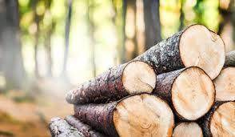
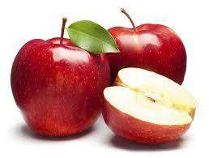
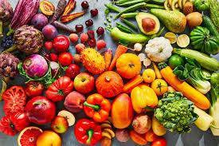
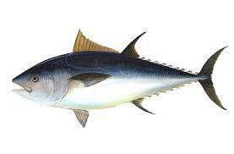
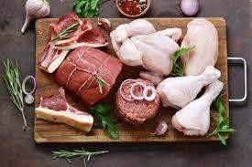
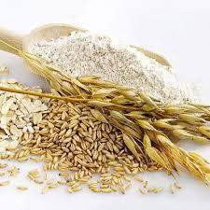
Primary bioresources
Primary bioresources are the raw materials obtained directly from nature without any processing.
These bioresources are generated for a specific application-oriented purpose in forestry, agriculture, and aquaculture to enable the production of food, substantial products, and energy.
It consists of : Agricultural crop Wood from forestry Marine bioresources

Slide 8
Characteristics of primary bioresources
It is directly obtained from nature.
Mostly used as food, raw materials for industries, medicinal purposes.
Minimal processing is required.
It acts as the basis for the survival of all living organisms.

Slide 9
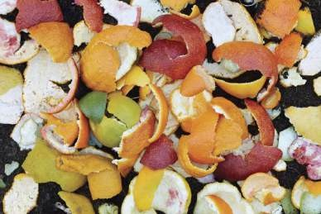
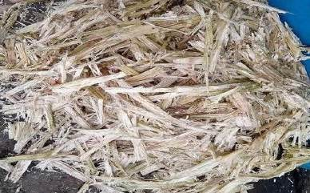
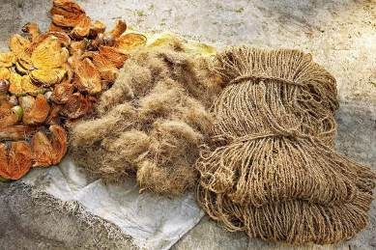
Secondary bio-resources
The bioresources that are produced as by-products or residues during primary processing are known as secondary bioresources.
Eg: Peel of fruits used for biogas production
Sugarcane bagasse used as biofuel (bioethanol)
Coconut husk used as coir

Slide 10
Characteristics of secondary bioresources
Derived from primary bioresources through some form of processing.
Requires processing of primary bioresources.
Increased value and usability compared to primary bioresources.

Slide 11
Tertiary bioresources
Tertiary bioresources are the materials or products that have undergone extensive processing or synthesis from primary and secondary bioresources.
Primary Bioresource: Wheat
A tertiary bioresource is a bio-based material that has been processed and transformed from primary and secondary bioresources into a final product or intermediate product with added value and specific functional properties.
Secondary Bioresource: Flour
Tertiary Bioresource: Bread

Slide 12
Characteristics of tertiary bioresources
It is processed or synthesized from secondary and primary bioresources.
It has specialized applications in various industries.
It involves complex processing and often biotechnological methods.
It has higher complexity and specificity in applications.

Slide 13
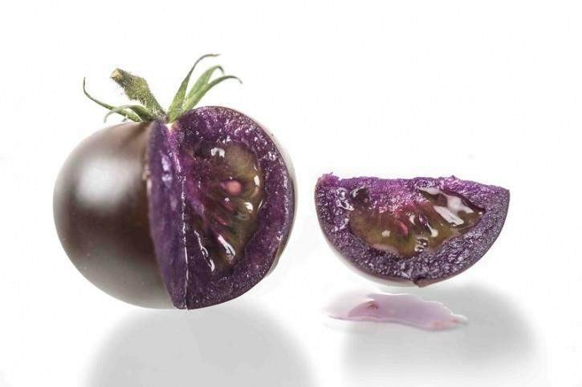
Quaternary Bioresources
Quaternary bioresources are advanced bioresources that involve the use of biotechnological and bioengineering innovations to develop and optimize biological processes and products.
These bioresources often include genetically modified organisms, bioinformatics tools, synthetic biology applications, and advanced bioproducts.
The GMO purple tomato is genetically engineered to have high levels of anthocyanins, which are antioxidants that give it its distinctive purple color and potentially offer additional health benefits.

Slide 14
Characteristics of quarternary bioresources
Involves the use of knowledge and information about bioresources.
It is used in research and development, innovation in bioresource applications.
It requires advanced technological and informational processing.

Slide 15
As raw materials for food products
Bioengineering
Biopreservation
Applications of Bioresources in Food Processing
Waste Management and Byproduct Utilization
Bioplastics and Biodegradable Packaging
Biofortification

Slide 16
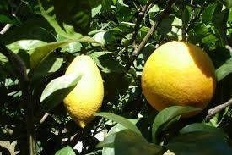
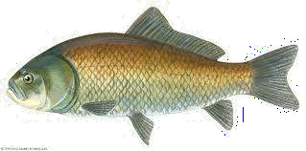
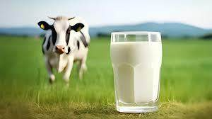
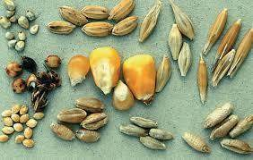
Applications of Bioresources in Food Processing
As raw materials for food products:
  Use of plants, animals, and microorganisms as primary ingredients for food products. This approach also supports the development of eco-friendly and health-conscious food innovations.
  Examples: Grains, fruits, vegetables, dairy, meat, and seafood.

Slide 17
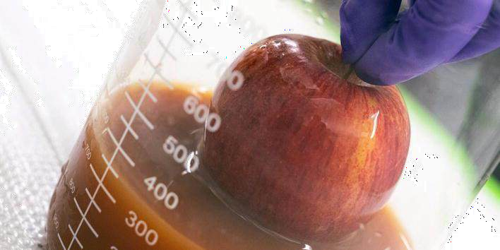
2. Bio-preservation:
Bioresources, such as beneficial microbes and natural extracts, are applied in biopreservation to extend the shelf life of food products by inhibiting spoilage organisms and pathogens.
Examples: Lactococcus lactis produces nisin that has antimicrobial properties and are used in dairy products, canned vegetables, and meat products to inhibit Gram-positive bacteria.
This approach also supports the development of eco- friendly and health-conscious food innovations., eugenol oil has antimicrobial properties and are used to extend the shelf life of food products

Slide 18
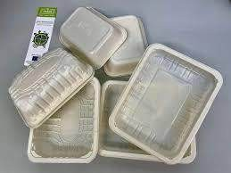
​Bioplastics and Biodegradable Packaging
  Development of eco-friendly packaging materials made from bioresources to reduce environmental impact.
  Examples: Bioplastics, edible films, and packaging made from starch, cellulose, or chitosan.

Slide 19
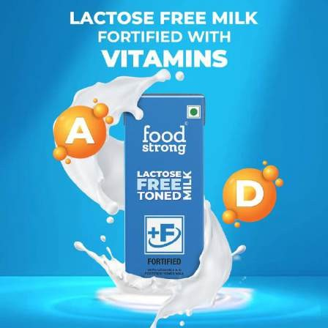
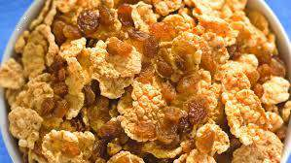
Biofortification
Enrichment of food products with essential vitamins and minerals derived from natural sources. Examples: Fortified cereals, dairy products enriched with calcium, and vitamin D.

Slide 20
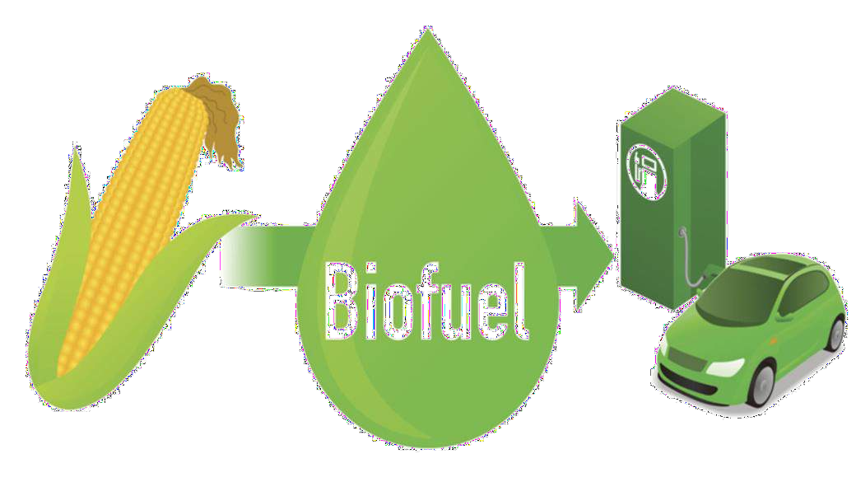
Waste Management and Byproduct Utilization
Bioresources are utilized in
waste
management to convert organic waste into valuable products like compost, biogas, and biofuels
Additionally, byproduct utilization transforms agricultural and industrial byproducts into
useful materials, reducing waste and promoting sustainability.

Slide 21
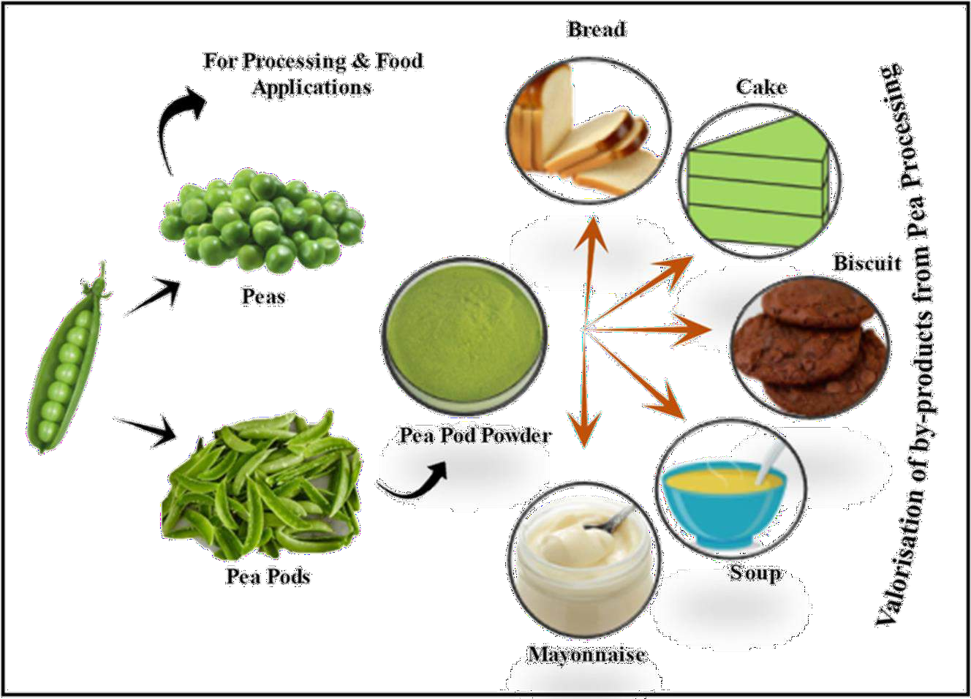

Slide 22
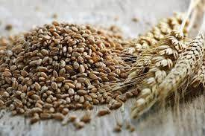
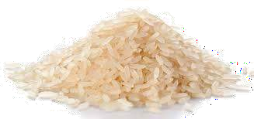
Concept of raw materials and ingredients
Raw materials refer to the basic, unprocessed resources, that are harvested or collected for use in the production of food products.
Milling
Raw material (Grain)
Rice (Food product)

Slide 23
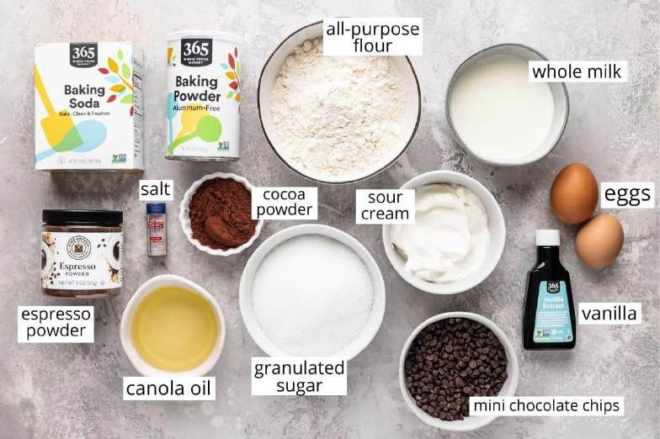
Ingredients are the components derived from the raw materials that are added, mixed, or processed together to create the final food product, such as flour, sugar, oils, and spices.

Slide 24
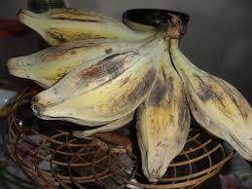
Underutilized bioresources
Underutilized bioresources refer to biological materials, such as certain plant species, agricultural byproducts, or microorganisms, that have valuable properties but are not widely used or fully exploited for their potential benefits.
These resources often remain untapped due to lack of awareness, technological constraints, or economic factors, despite their potential to contribute to food security, sustainability, and industrial applications.

Slide 25
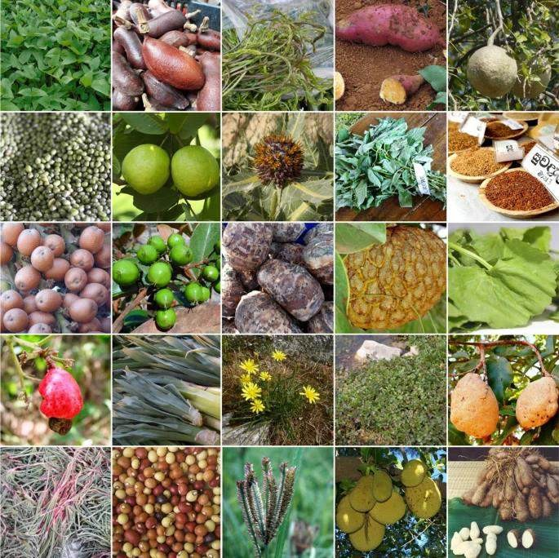

Slide 26
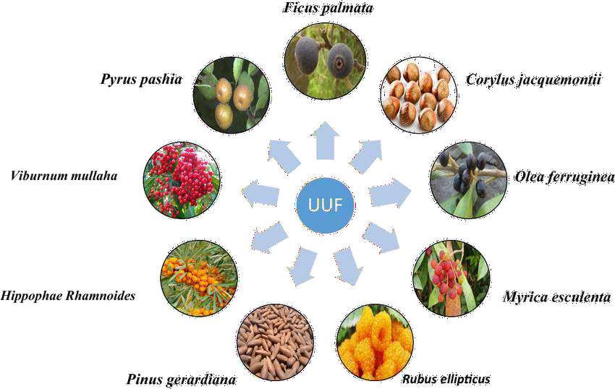

Slide 27
THANK YOU

